Slide 1
Optimal Coverage of Known Arbitary Environment
Raphael Mannadiar and Ioannis Rekleitis
2010 IEEE International Conference on Robotics and Automation
Anchorage Convention District
May 3-8, 2010, Anchorage, Alaska, USA
By Adwait Kulkarni
(U25712111)

Slide 2
Introduction

Slide 3
The paper "Optimal Coverage of a Known Arbitrary Environment" by Raphael Mannadiar and Ioannis Rekleitis, presented at the 2010 IEEE International Conference on Robotics and Automation, focuses on developing an algorithm for the complete coverage of known spaces using mobile robots. This algorithm is particularly relevant in applications like de-mining, vacuum cleaning, lawn mowing, and automated painting.
The main objective is to ensure that a robot covers all free spaces efficiently, following an optimal path in terms of distance traveled. To achieve this, the authors introduce a new algorithm based on Boustrophedon cellular decomposition, which involves dividing the space into cells and then using the solution to the Chinese Postman Problem (CPP) to calculate the optimal sequence of cell coverage.
This approach ensures complete coverage of the available space while minimizing the robot's path. An important aspect of this algorithm is its extension to consider the entry point of the robot in cell coverage, modifying the weights of the Reeb graph edges accordingly.

Slide 4
Evolution of Robotic Coverage Algorithms

Slide 5
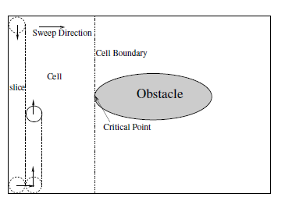
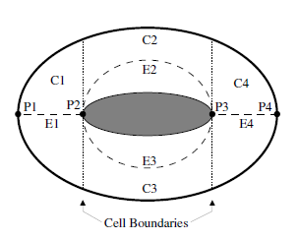
Boustrophedon Cellular Decomposition : Choset and Pignon first introduced a rigorous extension to the Seed Spreader algorithm under the name of Boustrophedon Decomposition . The work was further developed by Acar with experimental verification and for a variety of control Morse functions. Butler achieved complete coverage of unknown rectilinear environments using a square robot with contact sensing.
This approach utilizes the concepts of Boustrophedon Cellular Decomposition of unknown environments to optimally schedule the order of coverage. To better describe the algorithm, the following terms from single robot coverage are used: slice, cell, sweep direction, and critical point. The Boustrophedon decomposition is a type of Morse decomposition where the slice is a line. The robot follows the intersection of the slice and the area to be covered, thus covering the area with vertical back and forth motions. A cell is a region defined by the Boustrophedon decomposition where slice connectivity does not change. In other words, no obstacle breaks the connectivity of the slice

Slide 6
Coverage Strategies and Graph Theory

Slide 7
Different algorithms from graph theory have been used in robotics to guide exploration , mapping , and coverage in the past. Edmonds and Johnson presented an overview of different graph algorithms that are directly applicable to the problem of optimal coverage of a known environment.
An Euler tour is a circuit that covers every edge in a graph exactly once. Euler demonstrated that a necessary and sufficient condition for the existence of such a tour in a graph is that all nodes of the graph have even degree – such graphs are called Eulerian Graphs. A similar problem is the Chinese Postman Problem (CPP): find a shortest tour that traverses every edge at least once.
All of the new edges will by definition be part of the Euler tour; hence, the challenge is to choose edges such that the total cost – the sum of the individual costs of all the edges – of this Euler tour be minimized.
Euler tour can be extracted from an Eulerian graph. A simple and wildly inefficient algorithm was proposed : let G be the original graph. Repeatedly choose and remove edges whose deletion would not disconnect G unless there is no other choice until G is empty. The sequence of chosen edges is the Euler tour.

Slide 8
Optimal Coverage Algorithm

Slide 9
Construction of the Reeb Graph
The input to algorithm is a bitmap representation of the environment. This choice comes naturally as the testing environment that we employ, Player/Stage, uses the same representation.
A common assumption in most cellular decomposition algorithms is that no two critical points change the slice connectivity at the same time. This assumption is trivial to enforce by a small rotation of the sweep direction.
The first task is to sweep the bitmap. Without loss of generality we assume a sweep direction along the x-axis and record all the critical points/regions. During the sweep, the location of the cells is also recorded.
Finally, the critical points and the cells are encoded in the Reeb Graph. The resulting Reeb Graph G =< V;E > is used as input to the next step of the algorithm that calculates an Euler tour.
Optimal Coverage Algorithm
Part 2
Online Coverage using sequence of edges
Part1
Off-Line Analysis of Environment
BCD
RGC

Slide 10
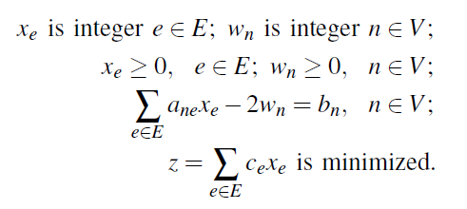
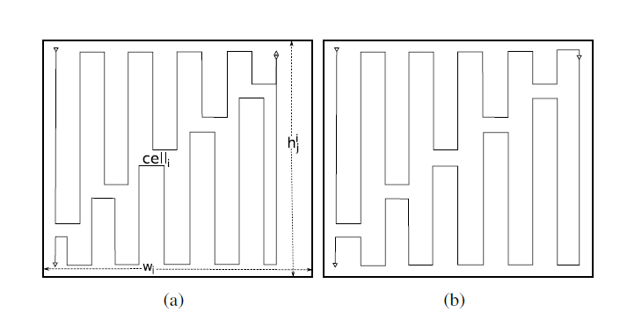
Construction of the Euler Tour
Boustrophedon Coverage
The primary contribution of algorithm is using the solution to the CPP in order to find the optimal order, in terms of distance travelled, in which the cells are covered. Given the Reeb graph, the next task would be to calculate an Euler tour.
This can be achieved by doubling selected edges of the Reeb Graph. Consequently, when the robot covers one of these doubled edges, it will split the cell into top and bottom sub-cells and assign each sub-cell to one of the two doubled edges.
The solution to the LP represents the Euler tour that is the routing of the robot.
This is The simple back-and-forth motion used for covering the interior of a cell is well documented in the literature, and covering it is beyond the scope of this presentation. The novel contribution of this algorithm is the treatment of the cells, which had their corresponding Reeb Graph edge doubled in order to generate an Euler tour. These cells are necessary to be traversed twice.
The coverage algorithm is modified to cover during the first traversal the top (or bottom) half of the cell, and in the second traversal to cover the bottom (or top) half of the cell correspondingly. The choice of which half to cover is dictated by the position of the robot at the end of the previous coverage task. Therefore, at the end of the coverage, the robot will have covered the complete cell without duplicating any work.

Slide 11
Key Take-Away Points

Slide 12
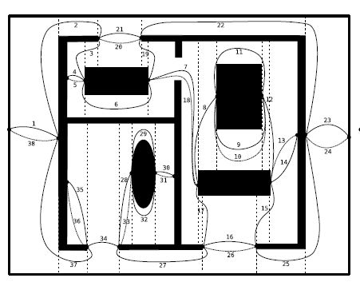
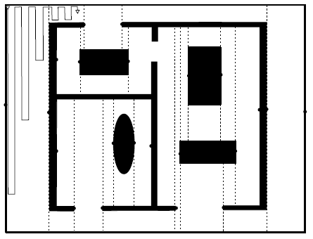
A new algorithm is introduced based on Boustrophedon cellular decomposition. This algorithm uses the Reeb graph to encode areas (cells) for coverage and utilizes the solution to the Chinese Postman Problem (CPP) for calculating an Euler tour. This tour ensures complete coverage of free space while minimizing the robot's path.
The classical solution to the CPP is also extended to consider the robot's entry point into cells, adjusting the weights of the Reeb graph edges to optimize the path.
The single cell coverage used in the Boustrophedon Cellular Decomposition algorithm is modified in order to eliminate repeat coverage by splitting selected cells into two components.

Slide 13
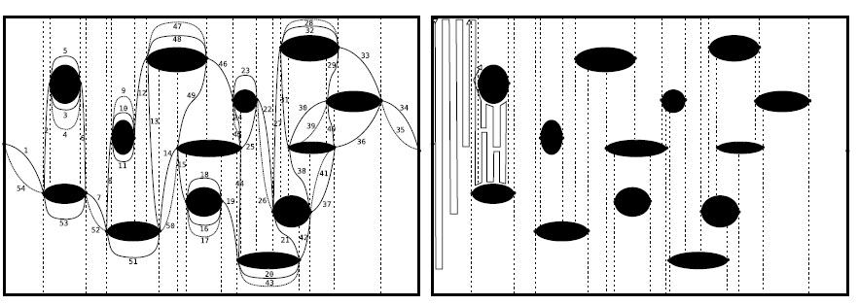
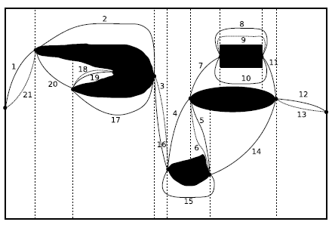
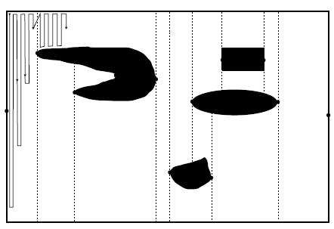

Slide 14
Weaknesses

Slide 15
Experiments using real hardware are scheduled for the near future in order to further validate their approach.
The paper focuses on optimizing the path length, but another important aspect in mobile robotics is energy efficiency. Future work could include energy considerations, finding a balance between the shortest path and energy-efficient movements, especially for battery-powered robots.
The algorithm is designed for known environments. Extending the algorithm to adapt to dynamic changes in the environment would make it more versatile and practical for real-world applications where environments are not static.
A more detailed comparison with other existing coverage algorithms would help in understanding the relative advantages and potential drawbacks of this approach.

Slide 16
Thank You

